Slide 1


DIABETES PREDICTION
Class : Machine Learning
Lecturer : Him Soklong
Presented By Group 2
Ly Seavmey
Chamroeun Vichita

Slide 2
CONTENTS
1.Introduction
2.Data Insights
3.Methodology
4.Comparative Analysis
5.Conclusion

Slide 3
1.INTRODUCTION
Diabetes is one of the most common chronic diseases worldwide. Early prediction can help doctors diagnose patients earlier and improve treatment outcomes.
The objective of this project is to build machine learning models that predict whether a patient has diabetes based on medical information and compare the performance of Logistic Regression and Random Forest.
Problem Type: Classification

Slide 4
1.INTRODUCTION
Dataset Description:
Source: Kaggle
Dataset: Diabetes Prediction Dataset
Target Variable (CLASS):
0 = Non-Diabetic
1 = Prediabetic
2 = Diabetic
Key Features: HbA1c, BMI, AGE, Glucose, Urea, Cr (Creatinine), Chol, TG, HDL, LDL, VLDL, Gender.

Slide 5
2.DATA INSIGHTS
Features
Column | Data type | Description
ID | int64 | Unique patient identifier
No_Pation | int64 | Patient number/record ID
Gender | object | Male or Female
AGE | int64 | Patient's age
Urea | float64 | Blood urea level

Slide 6
2.DATA INSIGHTS
Features
Column | Data type | Description
Cr | int64 | Creatinine level
HbA1c | float64 | Average blood glucose level over the past 2–3 months
Chol | float64 | Cholesterol level
TG | float64 | Triglyceride level
HDL | float64 | High-density lipoprotein ("good" cholesterol)

Slide 7
2.DATA INSIGHTS
Features
Column | Data type | Description
LDL | float64 | Low-density lipoprotein ("bad" cholesterol)
VLDL | float64 | Very low-density lipoprotein
BMI | float64 | Body Mass Index
CLASS | object | Target variable (Diabetic status)

Slide 8
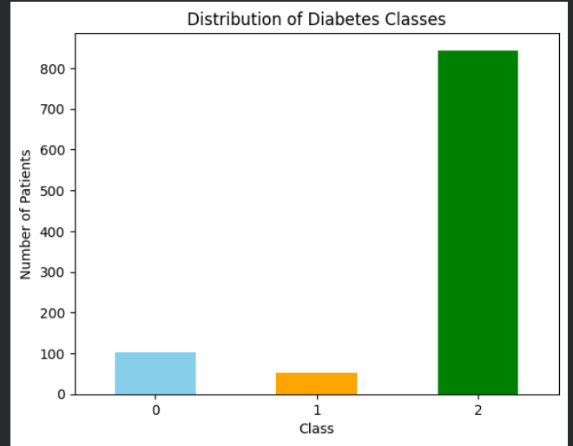
2.DATA INSIGHTS
How many patients are in each diagnosis Class ?
CLass 0 : Non-Diabetic
Class 1 : Pre-Diabetic
Class 2 : Diabetic

Slide 9
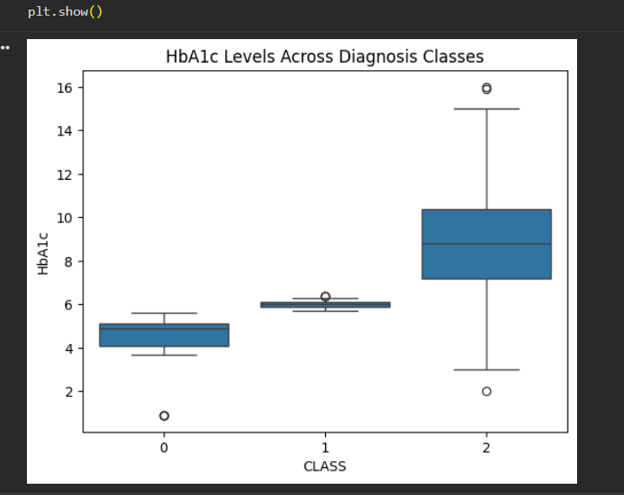
2.DATA INSIGHTS
Which HbA1c levels Range belongs to which Class?
Class 0 (Non-Diabetic): between 4.0 and 5.2.
Class 1 (Prediabetic): around 5.7 to 6.3.
Class 2 (Diabetic): between 7.0 and 10.5 (reaching up to 16).
Takeaway: Higher HbA1c levels strongly correlate with diabetes.

Slide 10
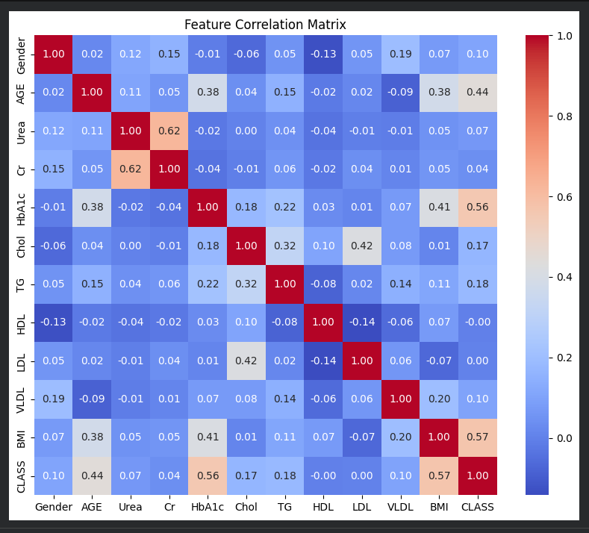
2.DATA INSIGHTS
Which features are most strongly tied to diabetes?
BMI (Body Mass Index) — Correlation: 0.57
HbA1c (%) — Correlation: 0.56
AGE — Correlation: 0.44

Slide 11
3.METHODOLOGY
Data Cleaning
Removed unnecessary columns (ID, No_Pation)
Encoded categorical variables (Gender, CLASS)
Standardized features for Logistic Regression
Split the dataset into 80% training and 20% testing

Slide 12
3.METHODOLOGY
Machine Learning Models
Logistic Regression:
Used as a baseline classification model.
Suitable for binary classification.
Hyperparameters tuned using GridSearchCV.

Slide 13
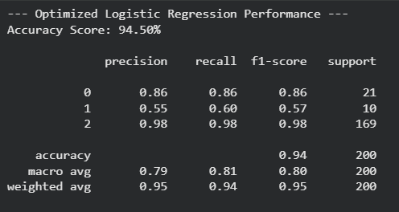
3.METHODOLOGY
3.METHODOLOGY
Logistic Regression:

Slide 14
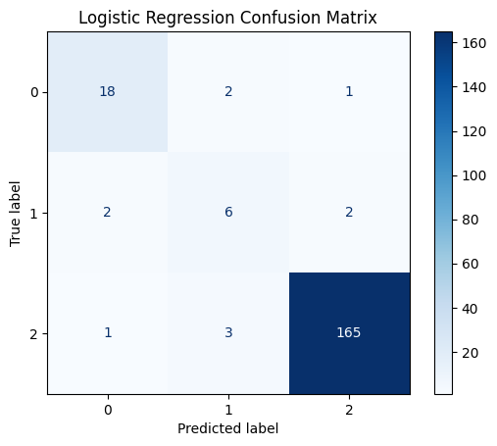
3.METHODOLOGY
3.METHODOLOGY
Logistic Regression:
Class 0: 18 correctly identified (True Negatives). 3 were misclassified (2 as Pre-diabetic, 1 as Diabetic).
Class 1: 6 correctly identified (True Positives). 4 were misclassified (2 as Non-diabetic, 2 as Diabetic).
Class 2 : 165 correctly identified (True Positives). 4 were misclassified (1 as Non-diabetic, 3 as Pre-diabetic).

Slide 15
3.METHODOLOGY
Machine Learning Models
Random Forest:
Ensemble learning algorithm based on multiple decision trees.
Handles nonlinear relationships effectively.
Hyperparameters optimized using GridSearchCV.

Slide 16
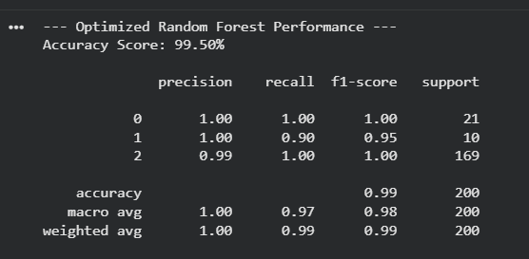
3.METHODOLOGY
Random Forest

Slide 17
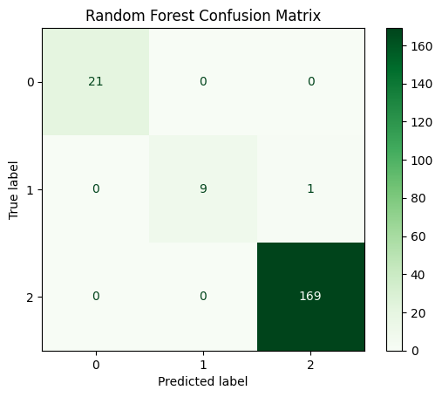
3.METHODOLOGY
Random Forest
Class 0 : correctly predicted all 21 of class 0. No misclassifications for this class.
Class 1: correctly predicted 9 of class 1. One of class 1 was misclassified as class 2 (Diabetic).
Class 2 : correctly predicted all 169 of class 2. There were no misclassifications for this class.

Slide 18
4.COMPARATIVE ANALYSIS

Slide 19
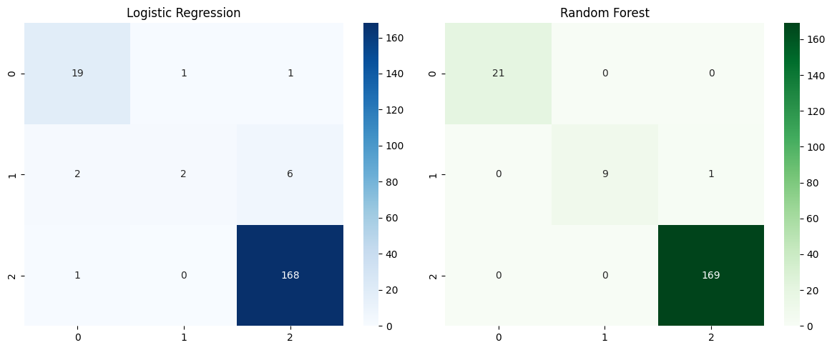
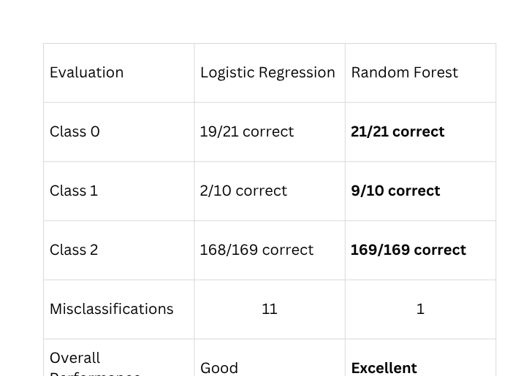
4.COMPARATIVE ANALYSIS

Slide 20
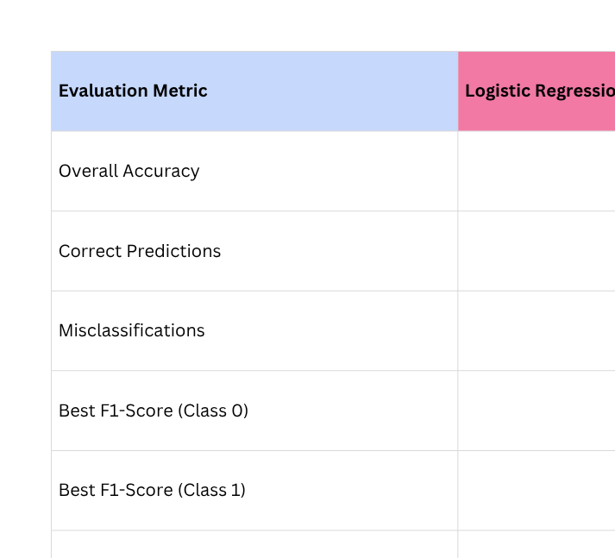
4.COMPARATIVE ANALYSIS

Slide 21

THANK YOU
VERY MUCH

